Slide 1



Robotic Process Automation (RPA)
Robotic Process Automation (RPA)
Machine Learning
Revolutionizing Efficiency
Revolutionizing Efficiency

Slide 2

Flight Fare Prediction project
A Data Science Project
By Ajwad Ansari (D001)
Smit Shah (D025)
A Data Science Approach

Slide 3

1
Introduction and Project Overview

Slide 4


Objective:
To Predict flight fares based on given parameters.
Dataset source:
Contains 10,000+ flight records.
The dataset focuses on predicting flight fares based on various attributes related to flight details. It contains over 10,000 records with features like the airline name, journey date, source and destination cities, total stops, route, departure and arrival times, and the ticket price (target variable). The data includes both numerical and categorical variables, with some missing values and data type inconsistencies that need preprocessing. This dataset is ideal for exploring relationships between flight characteristics and ticket prices, enabling predictive modeling for fare estimation.

Slide 5

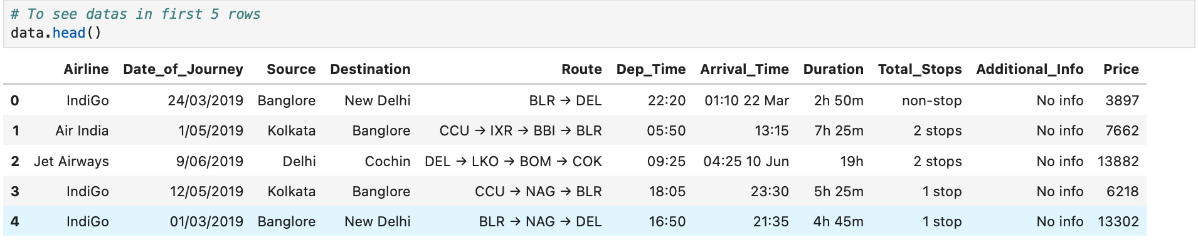
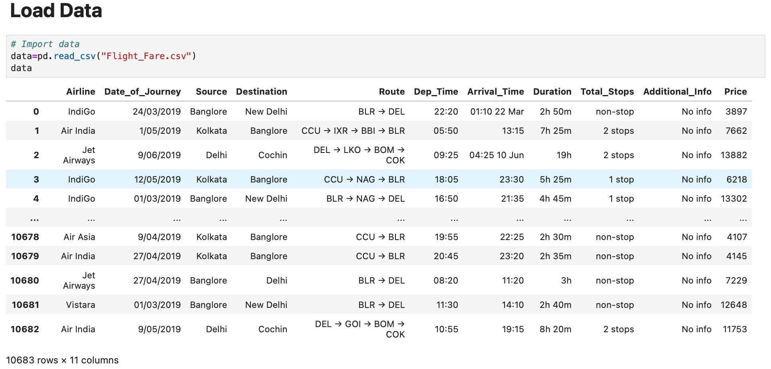
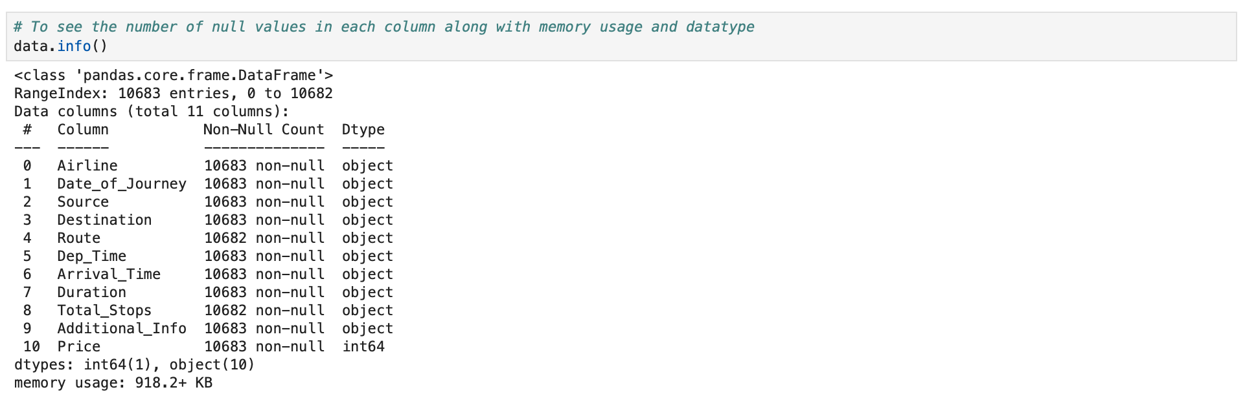
Dataset overview
Dataset Link :-
"/kaggle/input/flight-price-prediction-dataset/Data_Train.xlsx"

Slide 6

Inferences from the dataset
Popular airlines: Jet Airways have the highest frequency
High fares are associated with premium airlines like Jet Airways.
Stops significantly impact fares fewer stops mean higher prices

Slide 7
2
EDA

Slide 8
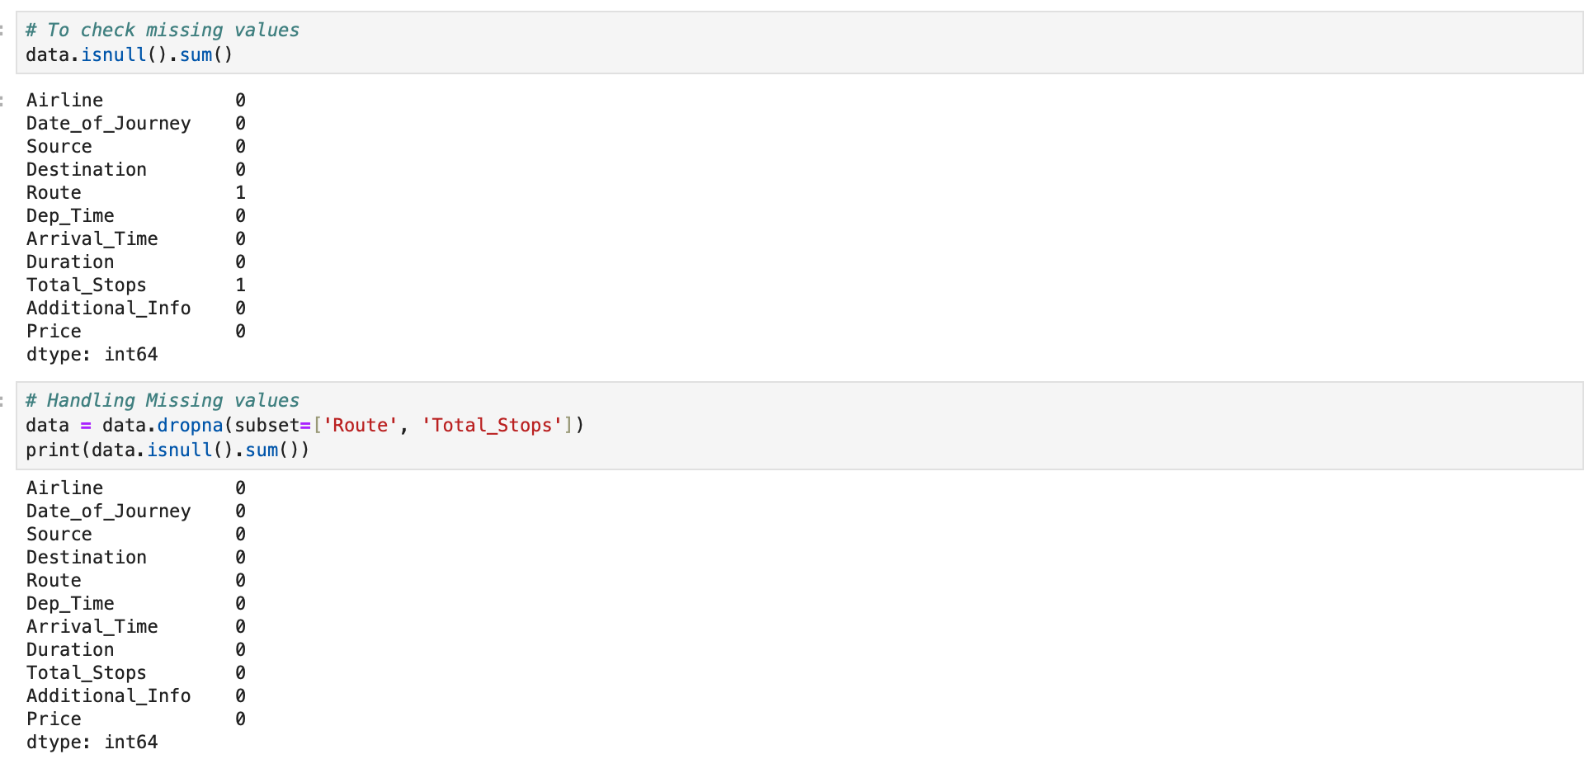
Handling Missing values

Slide 9
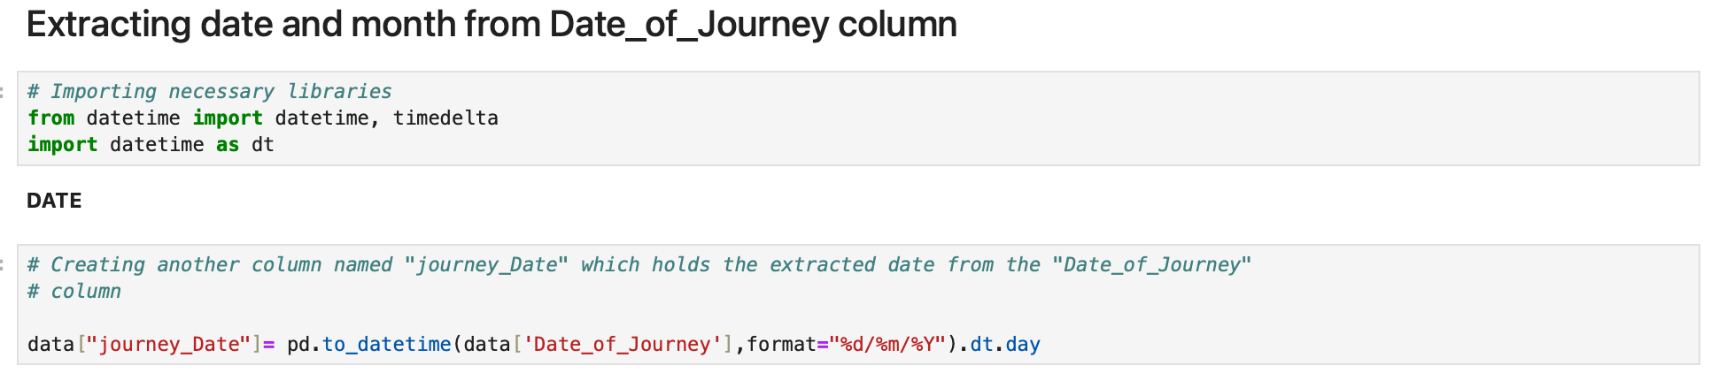
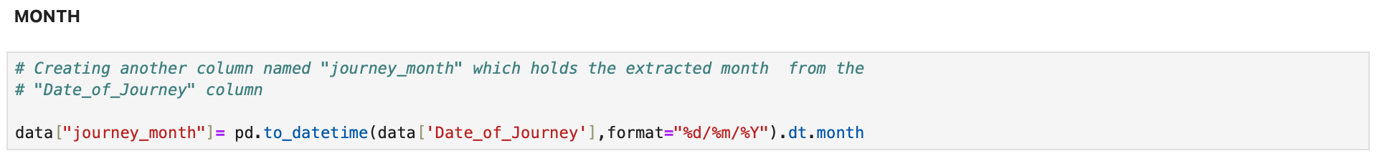
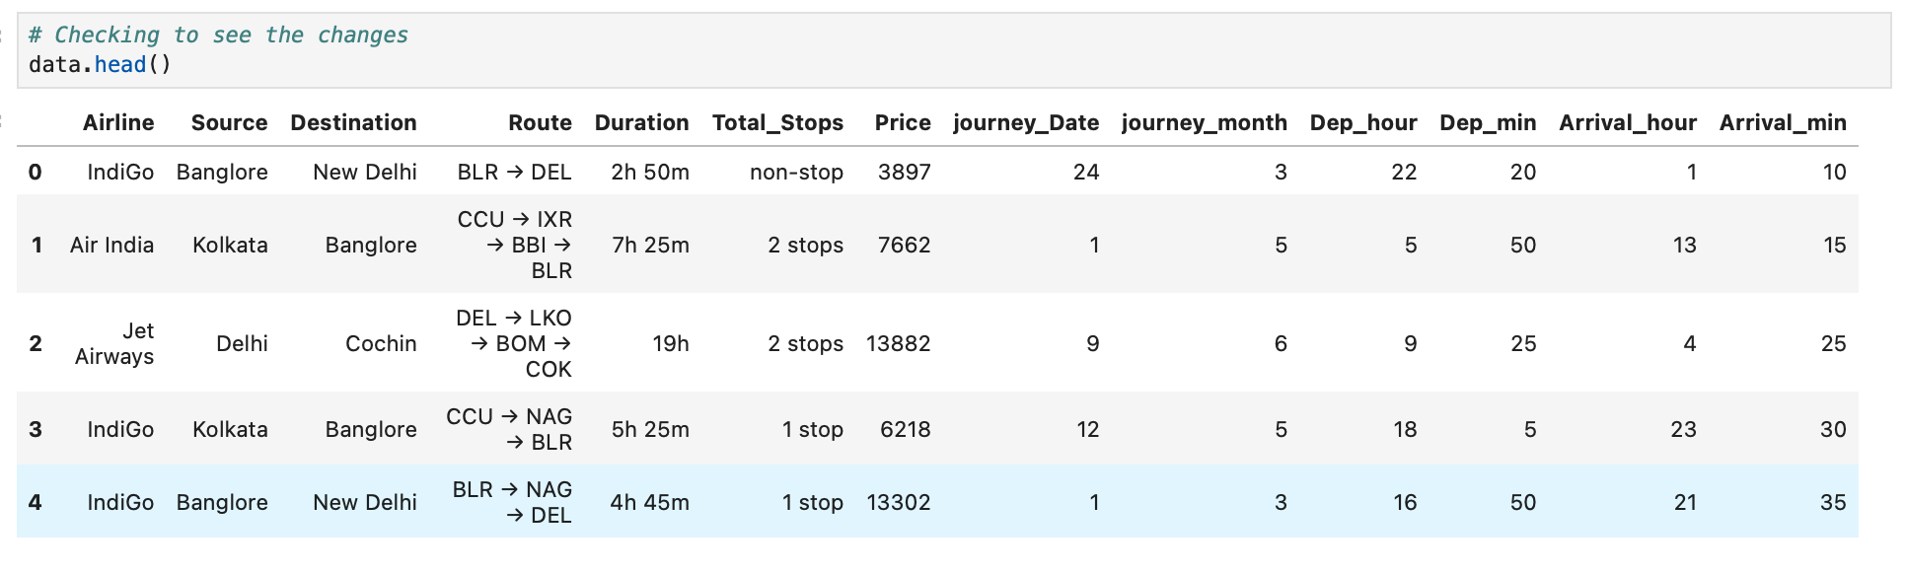
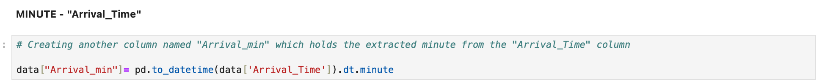
Feature Engineering
New Features Created:
Journey Day and Month: Extracted from Date_of_Journey.
Travel Duration: Converted hours and minutes into total minutes.
Time of Day:
Categorized departure time as Morning, Afternoon, Evening, or Night.
Encoded Features:
Applied One-Hot Encoding to categorical columns like Airline, Source.
After Feature Engineering

Slide 10
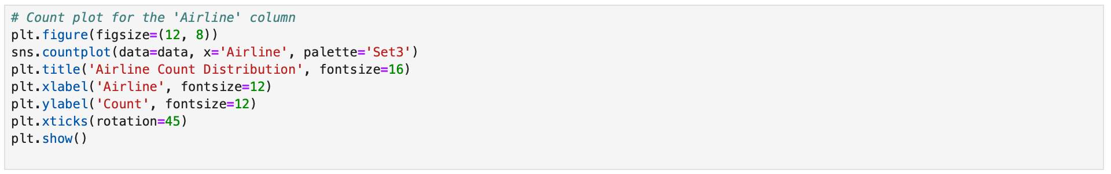
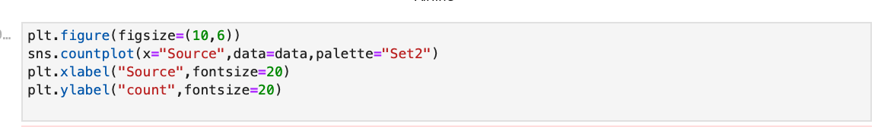
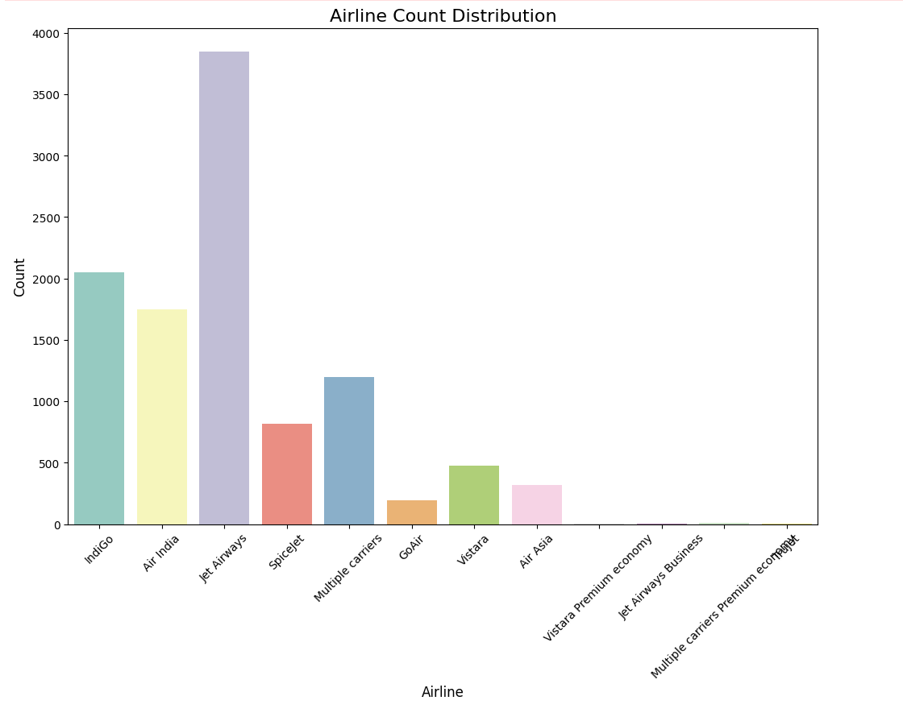
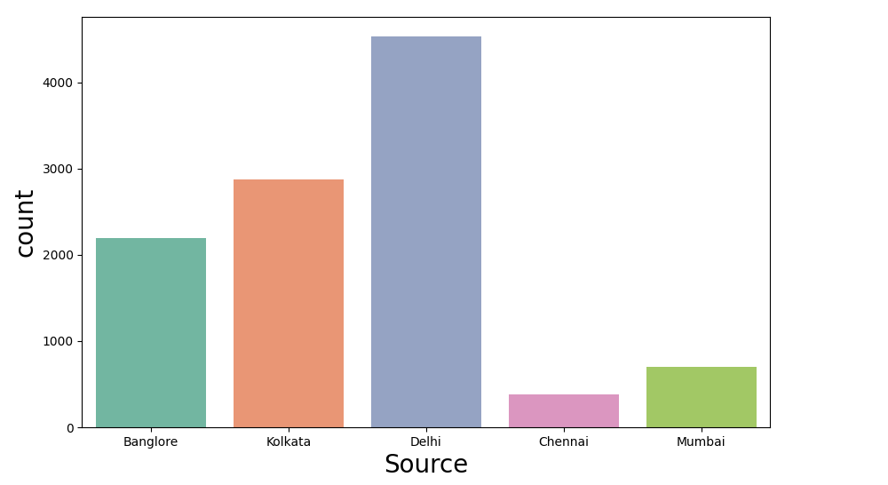

Slide 11
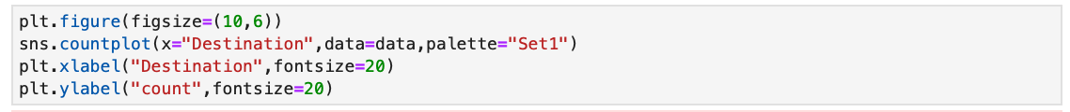
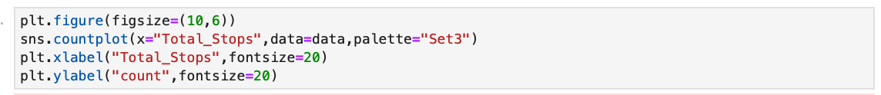
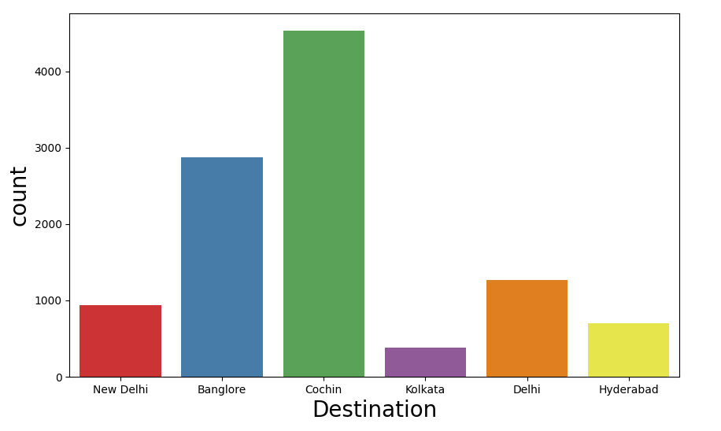
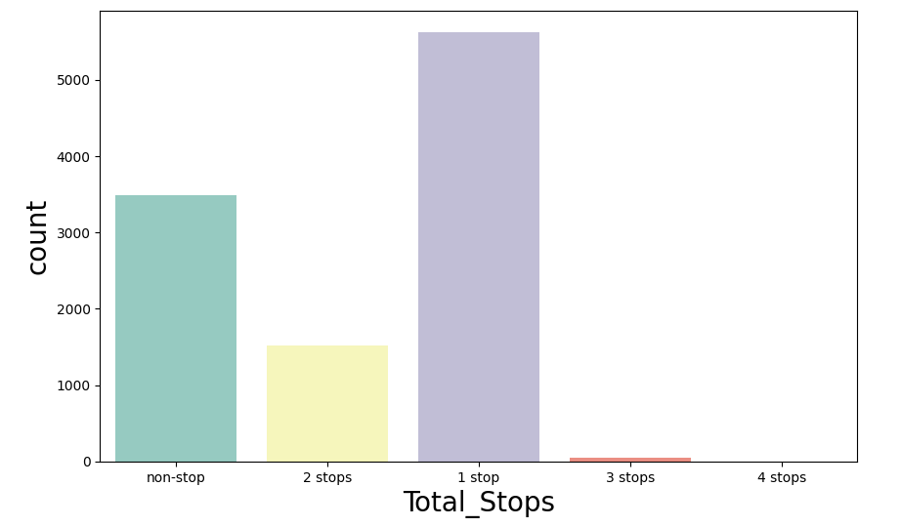

Slide 12
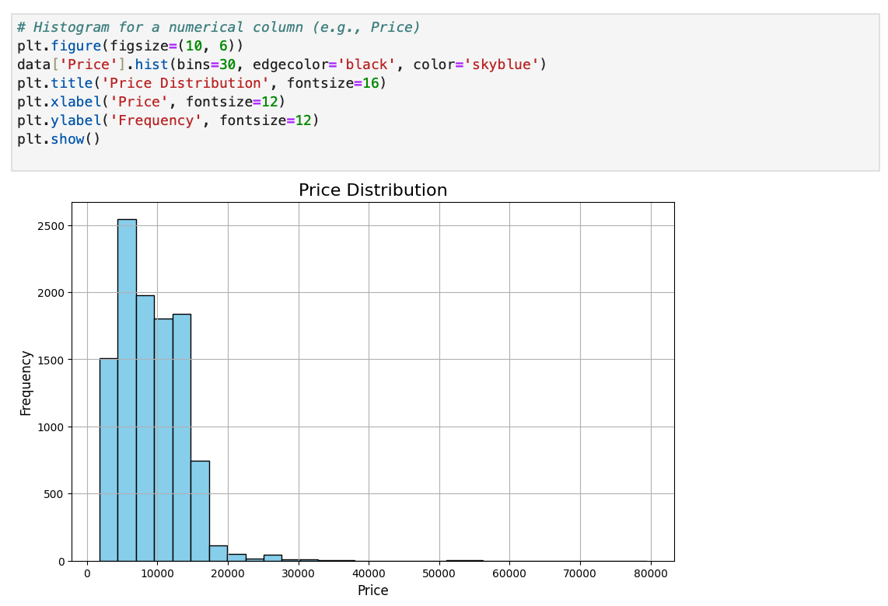
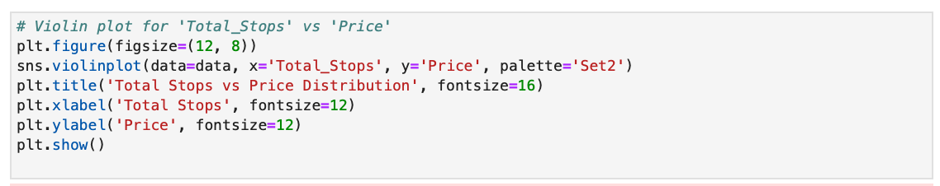
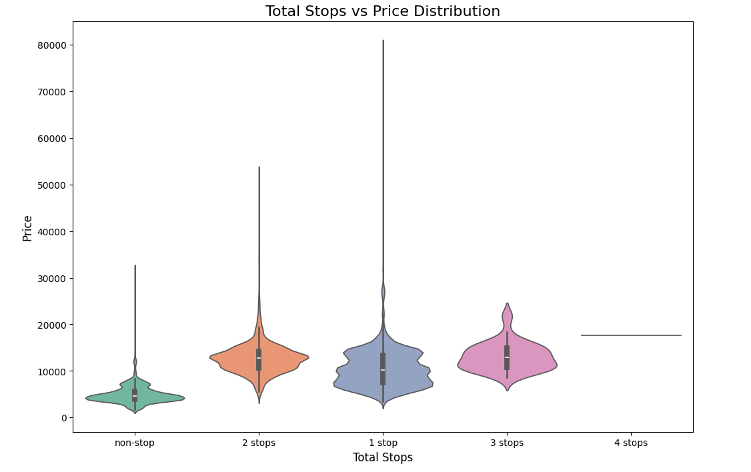

Slide 13
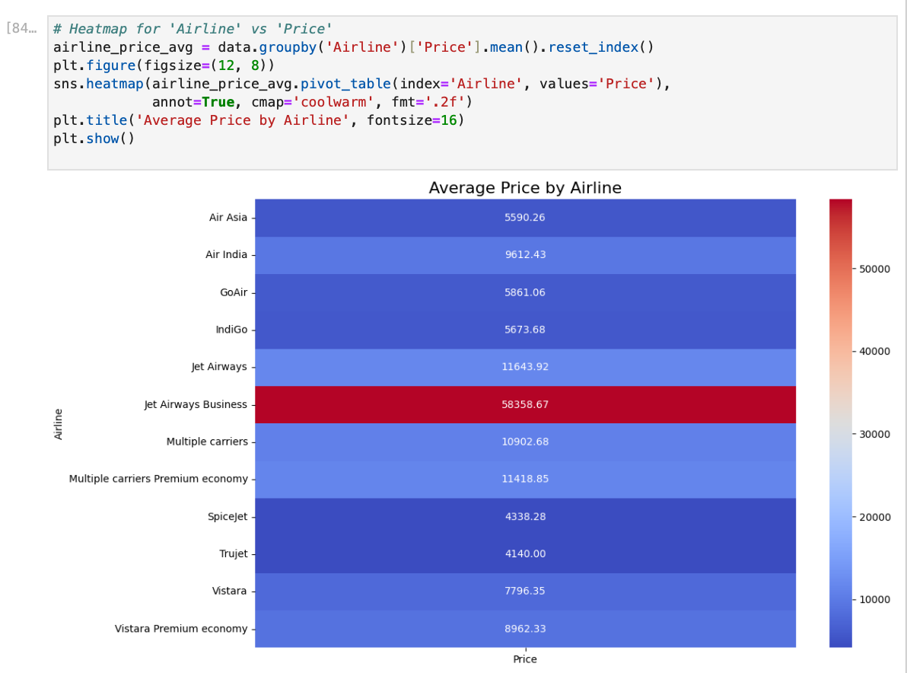
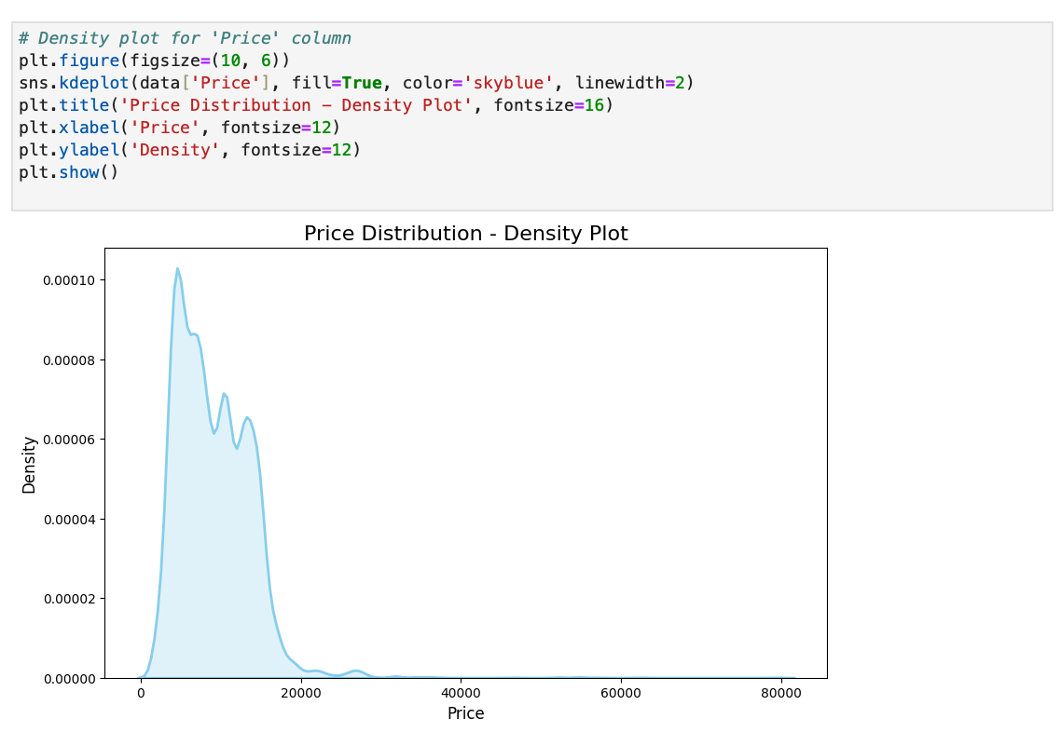

Slide 14
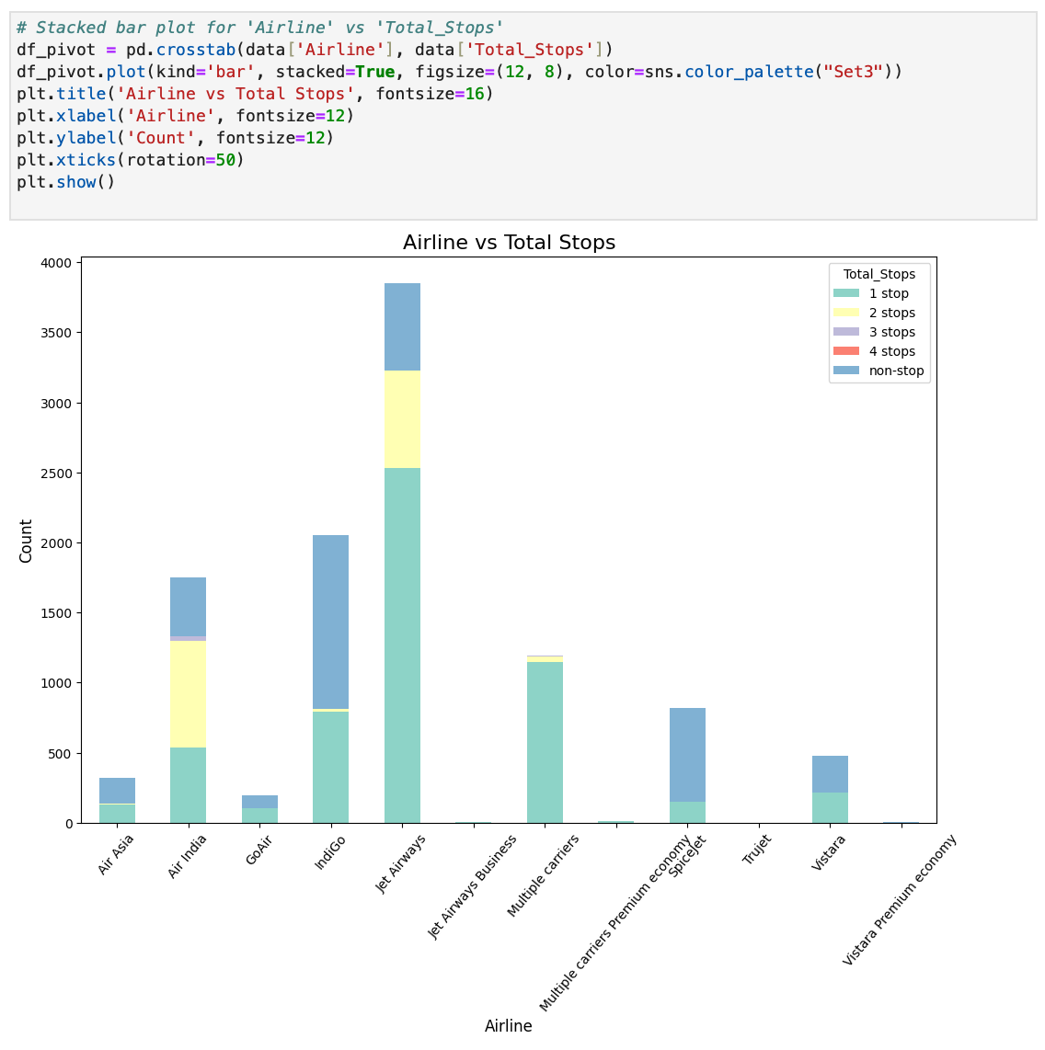
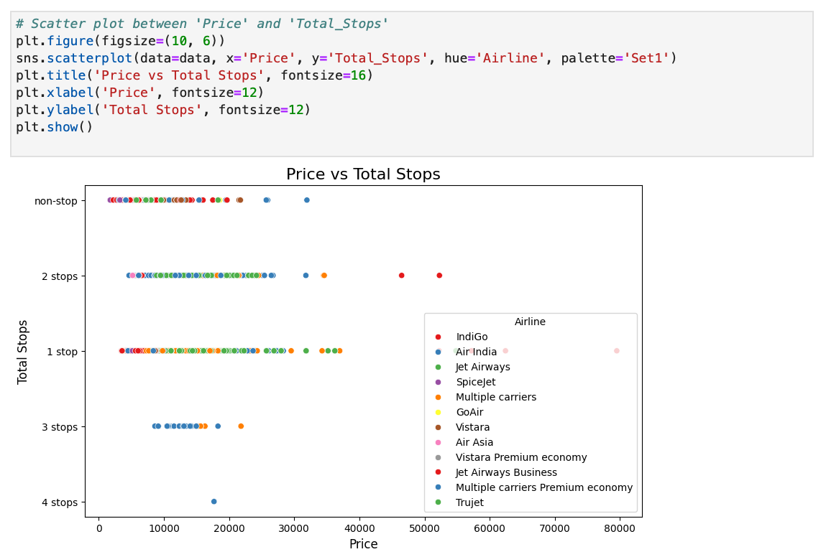

Slide 15
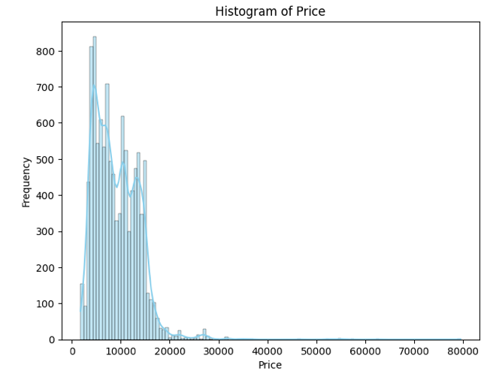
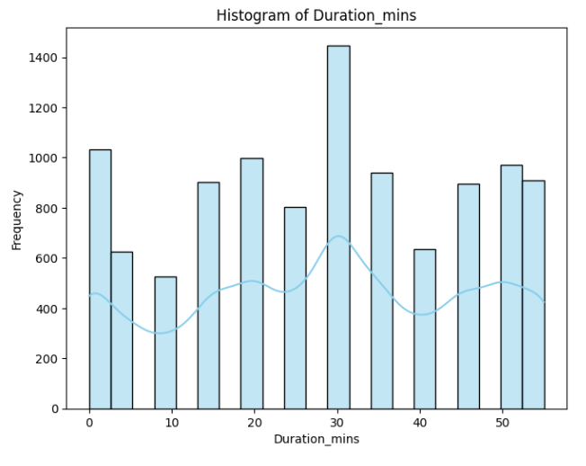
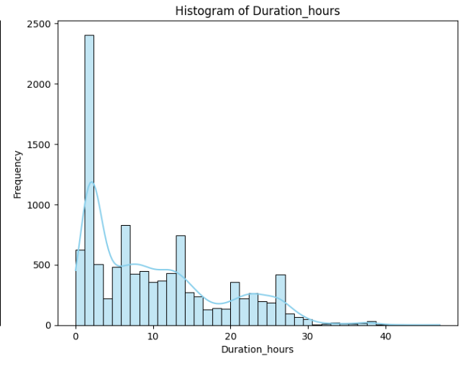
Skewness
Skewness is a statistical measure that describes the asymmetry of a distribution. It indicates whether the data leans more to the left or right from the center. Here's a breakdown:
Positive Skew(Right Skew)
Negative Skew (Left Skew)
Normal Distribution

Slide 16
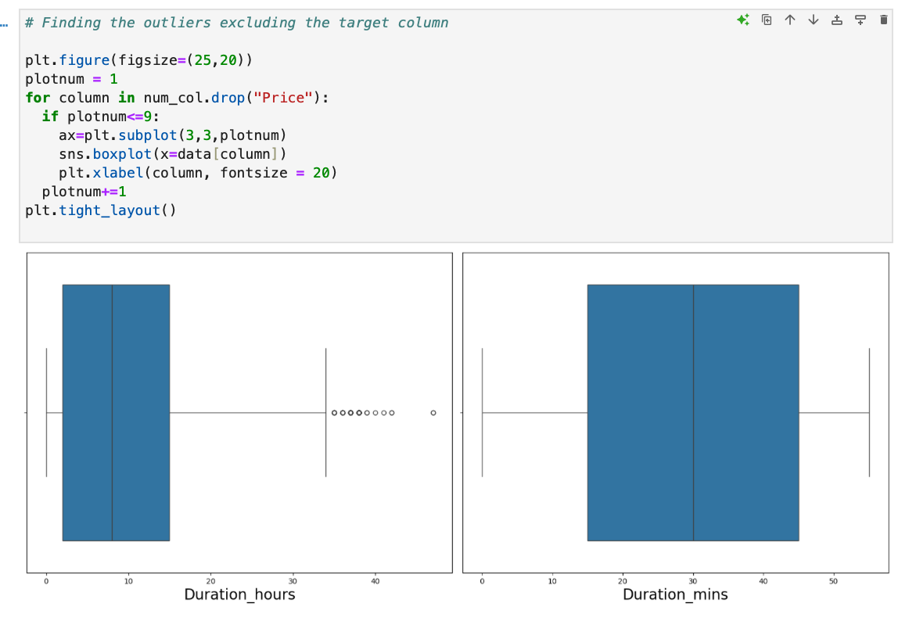
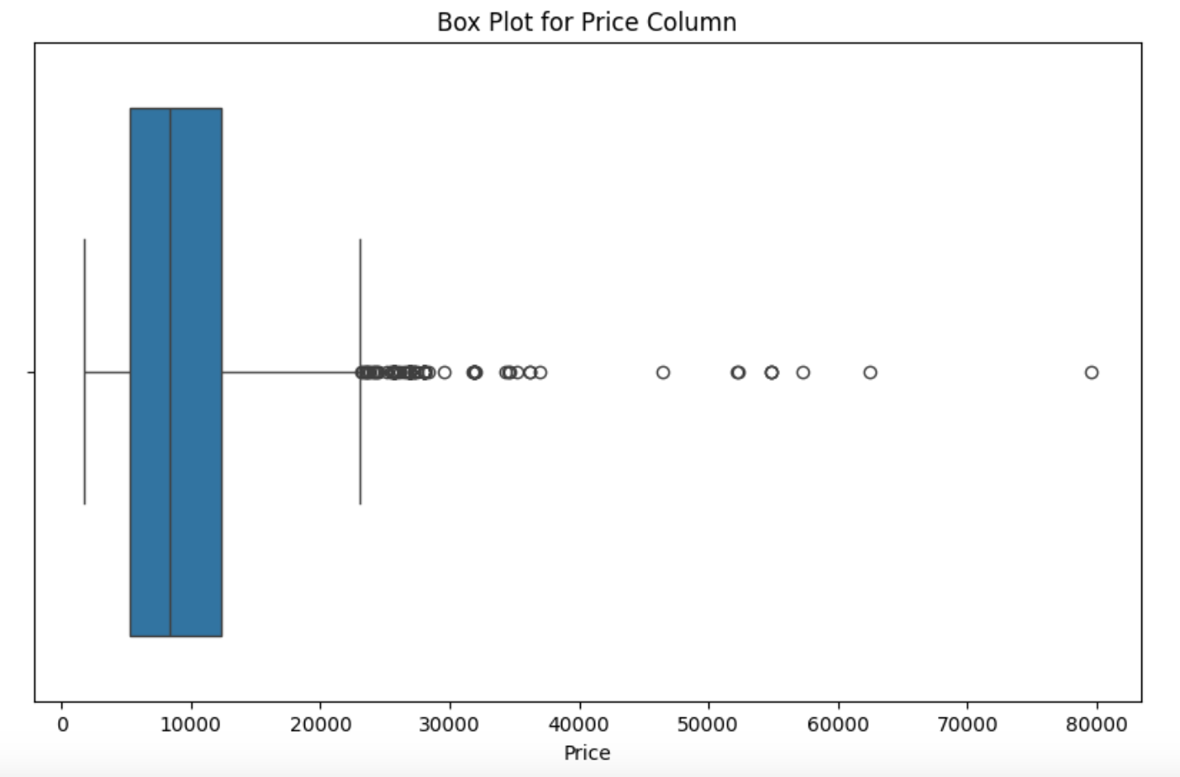
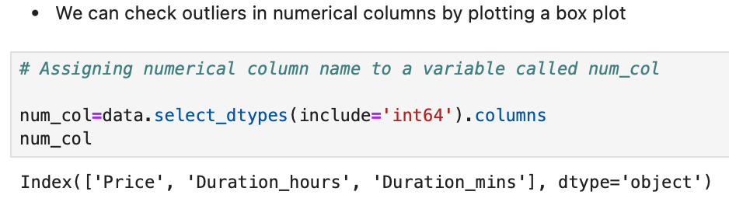
Outlier Handling in dataset
Methods Used for Outlier Detection
IQR (Interquartile Range):
Formula:
IQR=Q3−Q1IQR=Q3−Q1
Lower Bound: Q1−1.5×IQRQ1−1.5×IQR
Upper Bound: Q3+1.5×IQRQ3+1.5×IQR
Detects extreme values beyond these bounds.
Boxplot Visualization:
Used to identify outliers in numerical features like Price and Duration.

Slide 17
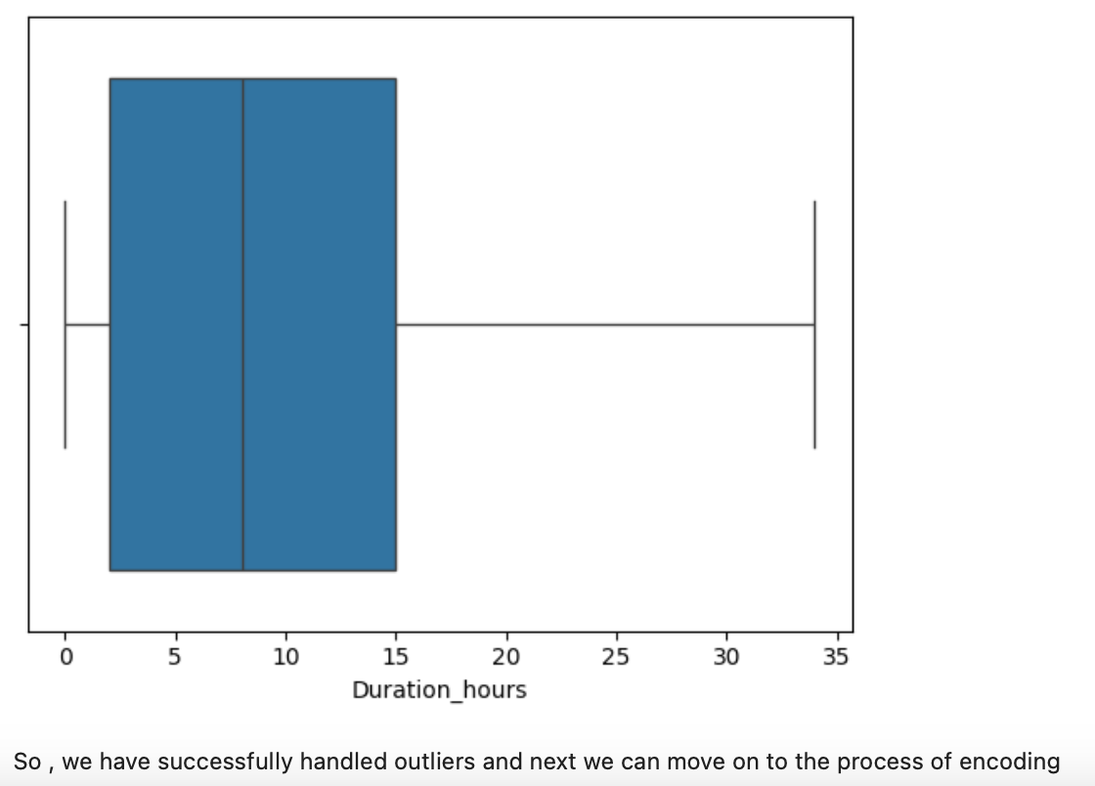
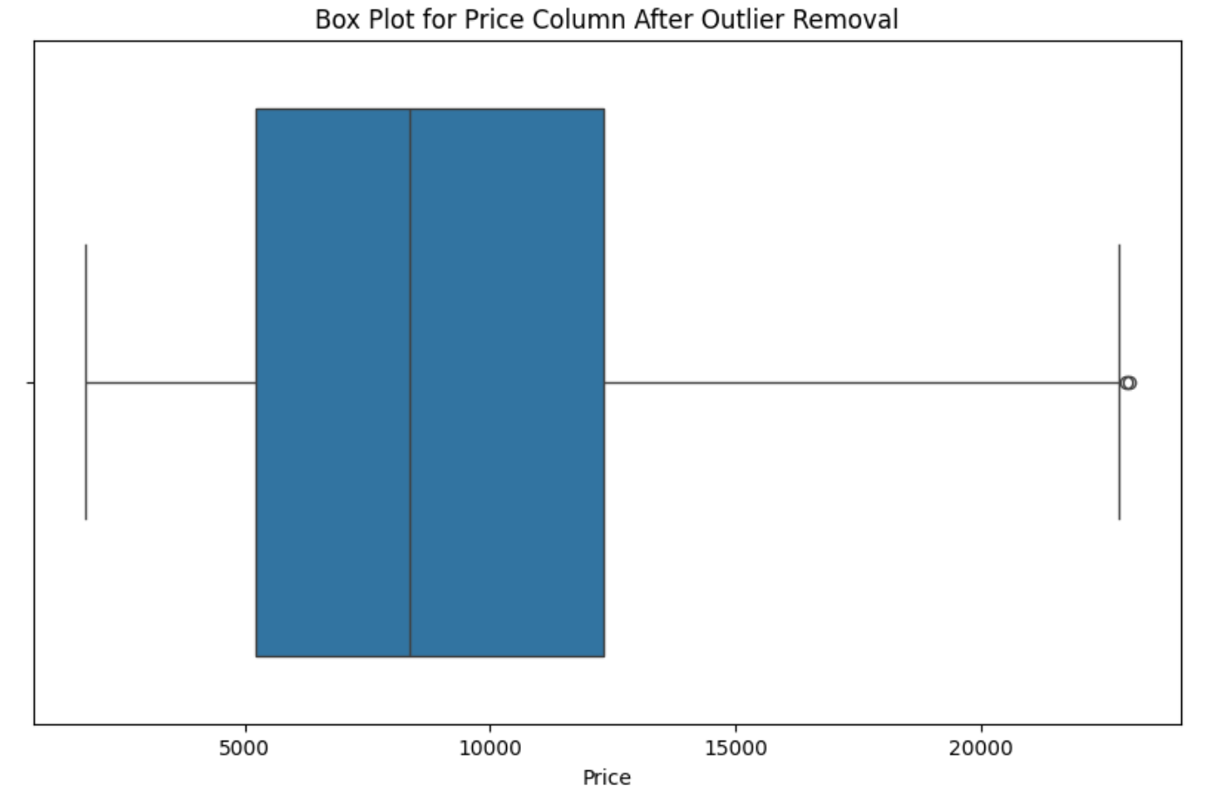
Outlier handling in dataset
Results of Outlier Handling
Improved model performance by reducing noise.
Ensured better generalization for predictions.
Steps Taken
Columns Analyzed: Price, Duration.
Removed/Transformed Outliers:
Outliers above the upper bound for Price were capped to the 95th percentile.
Duration outliers were flagged and examined for validity.

Slide 18
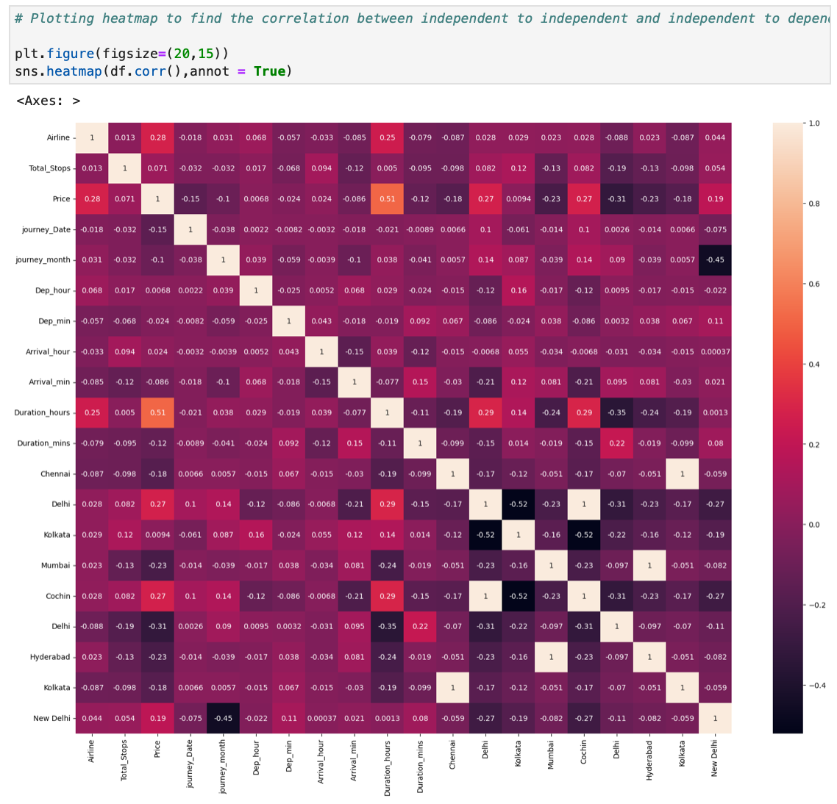
Feature Selection
INSIGHTS:
If two variables are highly correlated (e.g., correlation coefficient close to +1 or -1), it may be advisable to drop one of them to reduce multicollinearity.
Here , we dont have such variables. So no need to drop any column

Slide 19
3
Model

Slide 20
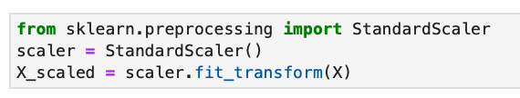
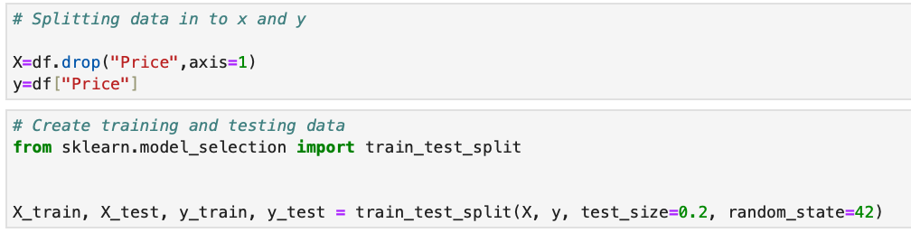
Train test splitting the dataset
Train-test split is a method used to evaluate the performance of a machine learning model. The dataset is divided into two parts: training data (used to train the model) and testing data (used to evaluate the model's performance on unseen data). Typically, the split ratio is 70:30 or 80:20. This ensures the model is tested on data it hasn't seen before, providing a reliable estimate of how well it will perform in real-world scenarios.
Scaling:
Train Test split:

Slide 21
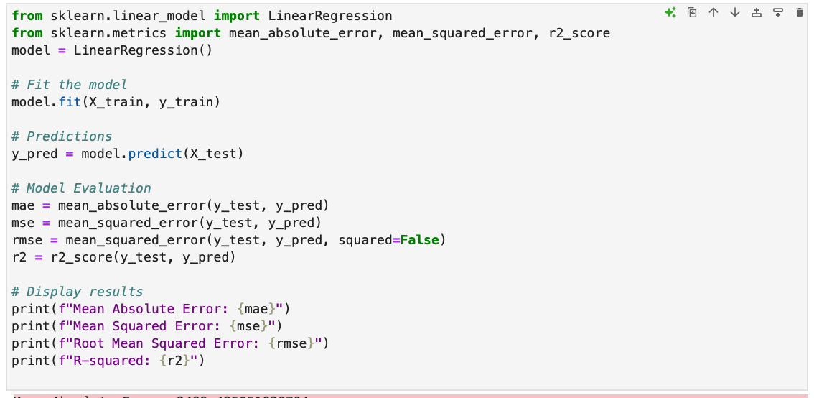
Linear regression
Prediction:
Mean Absolute Error: 2499.485051830704
Mean Squared Error: 12354567.553650578
Root Mean Squared Error: 3514.9064786492654
R-squared: 0.42702275850163574
Prediction:
Mean Absolute Error: 2499.485051830704
Mean Squared Error: 12354567.553650578
Root Mean Squared Error: 3514.9064786492654
R-squared: 0.42702275850163574
Summary: Linear Regression has the lowest accuracy and highest errors, indicating that it struggles to capture the complexity of the dataset.

Slide 22
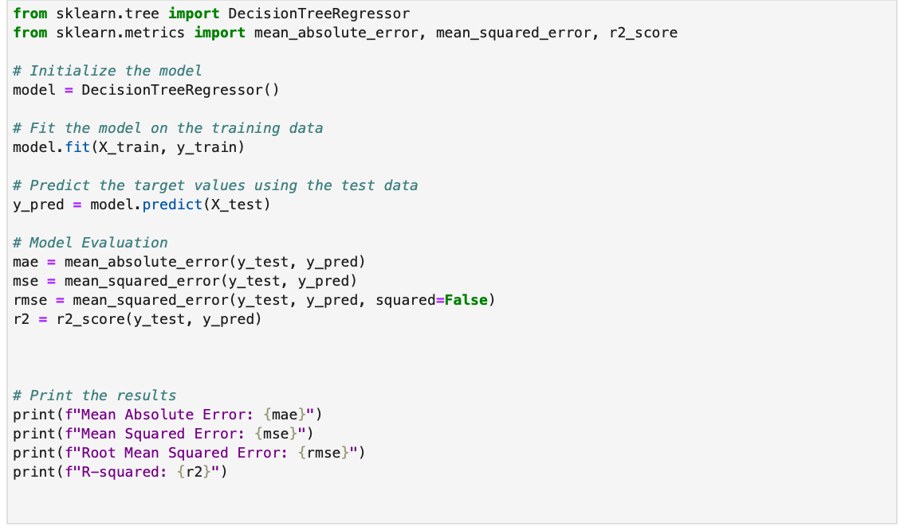
Decision Tree
Prediction:
Mean Absolute Error: 1334.8130166900642
Mean Squared Error: 6147073.409019524
Root Mean Squared Error: 2479.329225621221
R-squared: 0.7149124686159316
Summary: Decision Tree performs significantly better than Linear Regression, capturing non-linear patterns effectively.

Slide 23
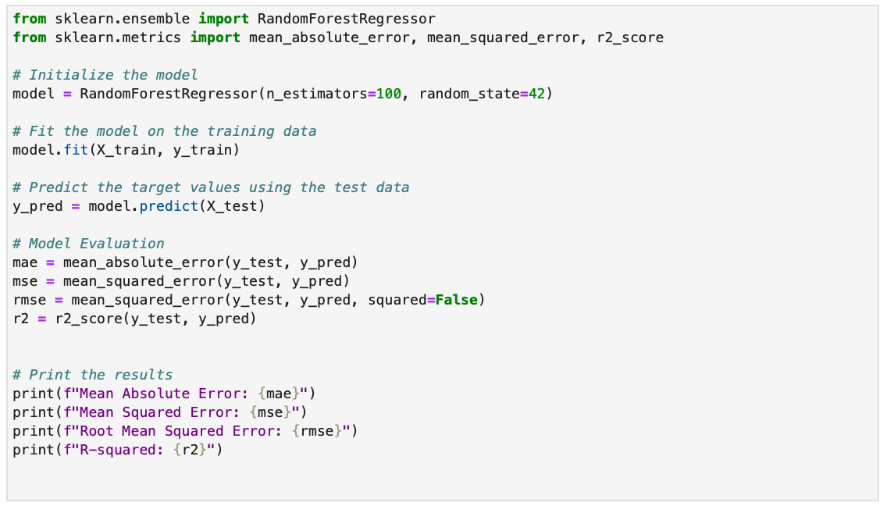
Random forest
Prediction:
Mean Absolute Error: 1177.532409673491
Mean Squared Error: 4413500.305582159
Root Mean Squared Error: 2100.833240783799
R-squared: 0.7953117161355095
Summary: Random Forest outperforms both Linear Regression and Decision Tree in all metrics, indicating its strong ability to generalize due to the ensemble approach.

Slide 24
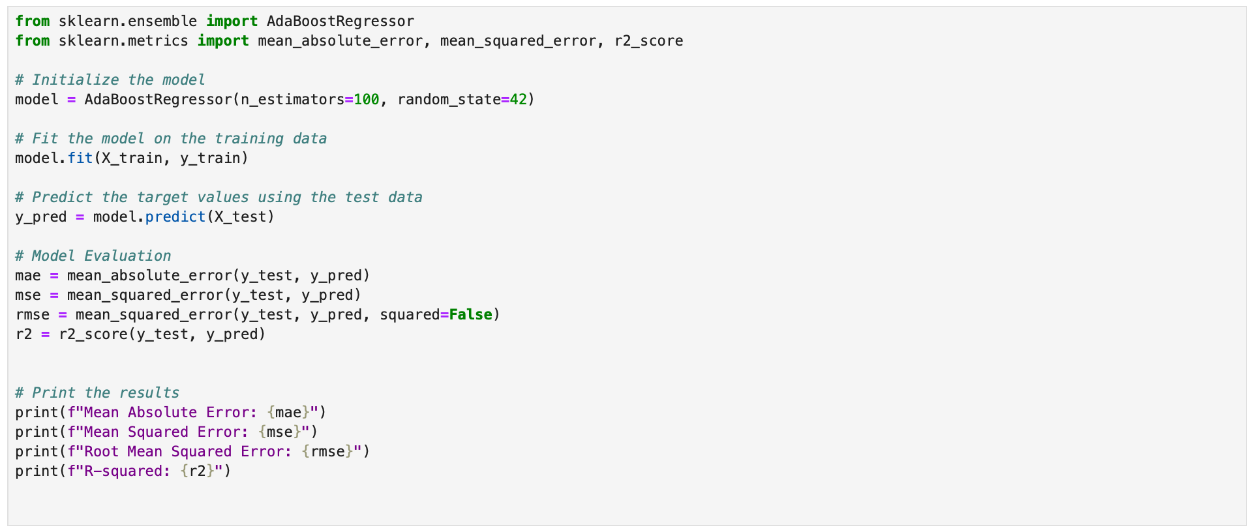
AdaBoost
Prediction:
Mean Absolute Error: 3036.8411445194997
Mean Squared Error: 13006455.317552991
Root Mean Squared Error: 3606.446355840191
R-squared: 0.3967896604101552
Summary: AdaBoost outperforms both Linear Regression and Decision Tree in all metrics, showcasing its strength in combining weak learners to achieve higher accuracy.

Slide 25
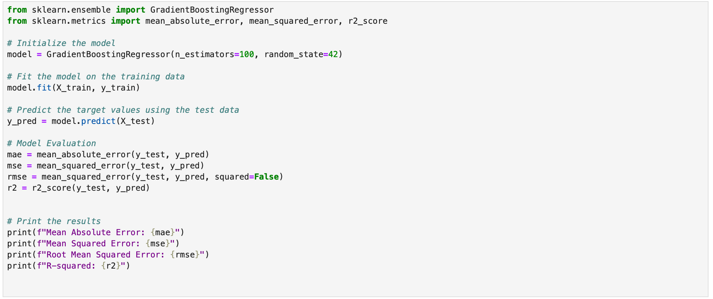
Gradient Boosting
Prediction:
Mean Absolute Error: 1540.9431126045145
Mean Squared Error: 4777678.673656122
Root Mean Squared Error: 2185.7901714611403
R-squared: 0.7784219370439915
Summary: Gradient Descent provides efficient optimization for minimizing the cost function, enabling improved performance in complex models compared to simple algorithms like Linear Regression.

Slide 26
4
Conclusion based on model evaluation

Slide 27
Conclusion and Next Steps
Conclusion based on model evaluation
Random Forest Regressor:
R² (0.7953) is the highest among all models, meaning it explains about 79.53% of the variance in the target variable.
It has the lowest errors with MAE (1177.53), MSE (4413500.31), and RMSE (2100.83).
Conclusion: This is the best-performing model, providing the most accurate predictions.
Gradient Boosting Regressor:
R² (0.7784) is slightly lower than Random Forest but still high.
Errors (MAE: 1540.94, MSE: 4777678.67, RMSE: 2185.79) are higher than Random Forest but better than other models.
Conclusion: This is the second-best model, suitable for capturing complex patterns in the data.
Decision Tree Regressor:
R² (0.7222) is moderately high, indicating a reasonable fit.
Errors (MAE: 1337.30, MSE: 5989211.28, RMSE: 2447.29) are higher than Random Forest and Gradient Boosting.
Conclusion: While effective, this model is outperformed by Random Forest and Gradient Boosting.
Linear Regression:
R² (0.4270) is relatively low, meaning it explains less of the variance in the target variable.
Errors (MAE: 2499.49, MSE: 12354567.55, RMSE: 3514.91) are significantly higher than most other models.
Conclusion: This model performs poorly compared to others and is not recommended for this dataset.
AdaBoost Regressor:
R² (0.3968) is the lowest among all models, indicating poor explanatory power.
Errors (MAE: 3036.84, MSE: 13006455.32, RMSE: 3606.45) are the highest.
Conclusion: This is the worst-performing model and should be avoided.
Final Recommendation:
Random Forest Regressor is the best model for this dataset, offering the most accurate predictions with the lowest errors.
Gradient Boosting Regressor is a strong alternative, especially if you suspect non-linear relationships in the data.

Slide 28
Thank you
Flight Fare Prediction project
A Data Science Project
By Ajwad Ansari (D001)
Smit Shah (D025)

